Slide 1
ME609
OPTIMIZATION METHODS IN ENGINEERING
PROJECT PHASE II
GROUP NO. 20
Kathir Ilakkiyan S M 200103125
Nameet 200104065

Slide 2
INTRODUCTION
Powell’s Conjugate Direction method:
The Conjugate Direction Method is an optimization technique used to find the minimum of a quadratic function by selecting a sequence of mutually orthogonal (conjugate) search directions. Parallel subspace property is used to find the conjugate directions. It's commonly used in numerical optimization and shares some similarities with the Conjugate Gradient Method.
Unidirectional Search Method:
Bracketing Method : Bounding Phase Method
Accurate Method : Secant Method

Slide 3

SUM SQUARES FUNCTION
S.No. | N | tol | Min x | Min value | Iterations
1 | 5 | 10⁻⁶ | [1.184e-16; 8.041e-18; -6.004e-19; 3.106e-19; -7.195e-19] | 0.000 | 2
2 | 4 | 10⁻⁵ | [-8.633e-17; 4.296e-18; -7.532e-18; -1.323e-17] | 0.000 | 2
3 | 3 | 10⁻⁵ | [-3.018e-15; 2.625e-20; -4.920e-18] | 0.000 | 2
4 | 2 | 10⁻⁷ | [1.024e-17; -1.075e-16] | 0.000 | 2
5 | 2 | 10⁻⁴ | [-2.044e-18; -8.863e-16] | 0.000 | 2
6 | 3 | 10⁻⁴ | [3.044e-15; -1.964e-18; -1.990e-18] | 0.000 | 2
7 | 4 | 10⁻⁴ | [1.490e-15; 7.882e-20; 2.881e-19; 5.546e-19] | 0.000 | 2
8 | 4 | 10⁻⁶ | [-8.748e-15; 7.982e-19; -9.143e-19; -1.481e-17] | 0.000 | 2
9 | 5 | 10⁻⁵ | [1.925e-14; -1.248e-18; -6.764e-18; -2.033e-18; 3.613e-18] | 0.000 | 2
10 | 3 | 10⁻⁷ | [9.959e-16;-9.864e-19;-5.676e-18] | 0.000 | 2

Slide 4
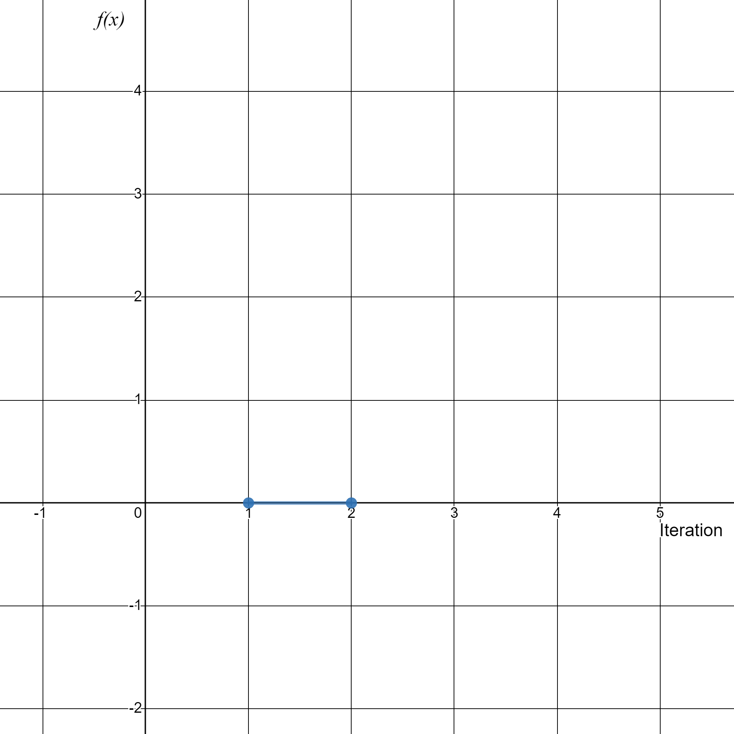

Slide 5

2) ROSENBROCK FUNCTION
S.No. | N | tol | Min x | Min value | Iterations
1 | 3 | 10⁻⁶ | [1.008; 1.016; 1.032] | 0.000 | 60
2 | 3 | 10⁻⁵ | [0.995; 0.990; 0.981] | 0.0001 | 56
3 | 2 | 10⁻⁵ | [1.000; 1.002] | 0.0002 | 92
4 | 2 | 10⁻⁶ | [1.193; 1.416] | 0.042 | 18
5 | 3 | 10⁻⁴ | [1.000; 0.996; 0.993] | 0.0013 | 58
6 | 3 | 0.5*10⁻⁴ | [1.004; 1.007; 1.015] | 0.0002 | 100
7 | 2 | 0.5*10⁻⁵ | [0.942; 0.888] | 0.003 | 28
8 | 2 | 0.5*10⁻⁶ | [0.898;0.804] | 0.010 | 17
9 | 3 | 0.5*10⁻⁵ | [1.024; 1.046; 1.094] | 0.002 | 35
10 | 3 | 0.5*10⁻⁶ | [0.987; 0.971; 0.944] | 0.001 | 100

Slide 6
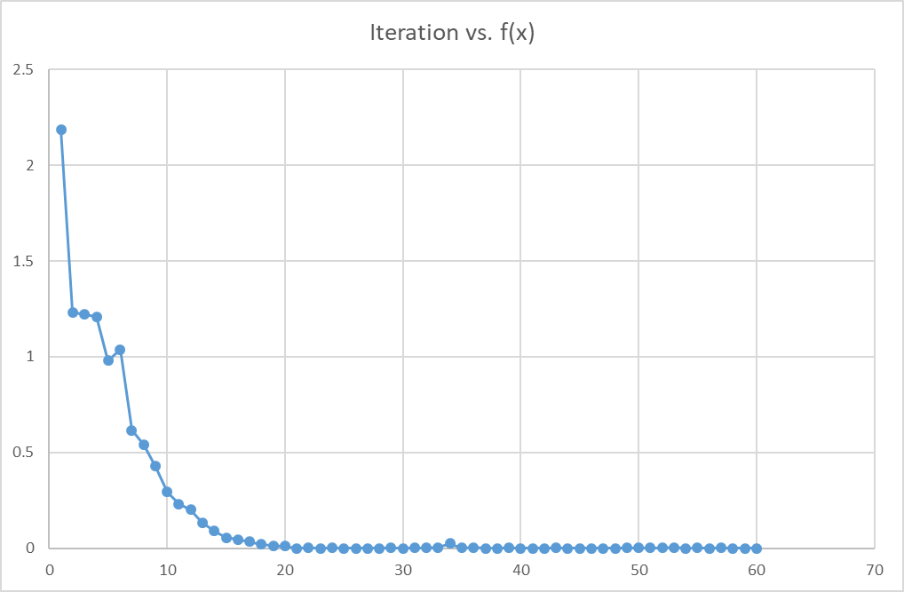

Slide 7

4) TRID FUNCTION
S.No. | N | tol | Min x | Min value | Iterations
1 | 6 | 0.5*10⁻⁶ | [5.995; 9.996; 11.996; 11.997; 9.998; 5.999] | -49.999 | 38
2 | 5 | 10⁻⁵ | [4.998; 7.998; 8.998; 7.999; 4.999] | -29.999 | 58
3 | 3 | 10⁻⁵ | [2.999; 3.999; 2.999] | -7.000 | 12
4 | 2 | 10⁻⁷ | [1.979; 2.115] | -1.983 | 10
5 | 3 | 10⁻⁷ | [3.000; 4.000; 3.000] | -7.000 | 22
6 | 3 | 10⁻⁴ | [3.005; 4.003; 3.001] | -6.999 | 8
7 | 4 | 10⁻⁴ | [3.999; 5.999; 5.999; 3.999] | -16.000 | 17
8 | 4 | 10⁻⁶ | [3.999; 5.999; 5.999; 3.999] | -16.000 | 55
9 | 5 | 10⁻⁶ | [5.005; 8.004; 9.003; 8.002; 5.001] | -29.999 | 86
10 | 3 | 10⁻⁶ | [3.000; 4.000; 3.000] | -7.000 | 20

Slide 8
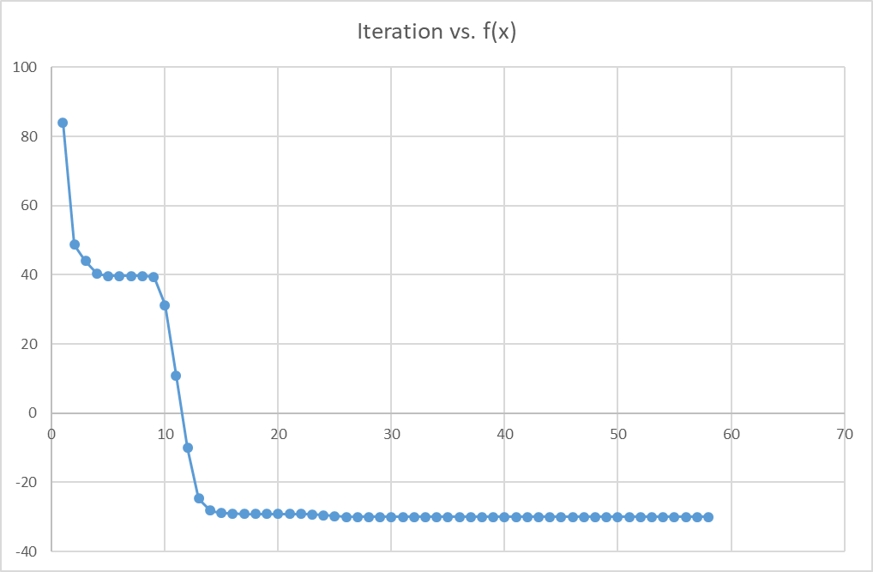

Slide 9

5) ZAKHAROV FUNCTION
S.No. | N | tol | Min x | Min value | Iterations
1 | 2 | 10⁻⁶ | [0.0009; 0.0006] | 0.000 | 20
2 | 3 | 10⁻⁶ | [2.598e-05; -8.993e-06; -1.030e-05] | 0.000 | 21
3 | 3 | 10⁻⁵ | [1.132e-07; -2.160e-06; 1.242e-06] | 0.000 | 12
4 | 3 | 10⁻⁴ | [-6.965e-05; 2.543e-05; 2.684e-05] | 0.000 | 11
5 | 2 | 10⁻⁸ | [-0.021; -0.016] | 0.003 | 76
6 | 2 | 10⁻⁷ | [8.455e-14; 1.876e-11] | 0.000 | 48
7 | 2 | 10⁻⁵ | [0.001; 0.001] | 0.000 | 46
8 | 3 | 10⁻³ | [-0.0003; 0.0001; 0.0001] | 0.000 | 10
9 | 2 | 0.5*10⁻⁶ | [3.963e-07; -7.405e-07] | 0.000 | 31
10 | 3 | 0.5*10⁻⁶ | [-1.109e-06; 4.002e-07; 4.305e-07] | 0.000 | 35

Slide 10
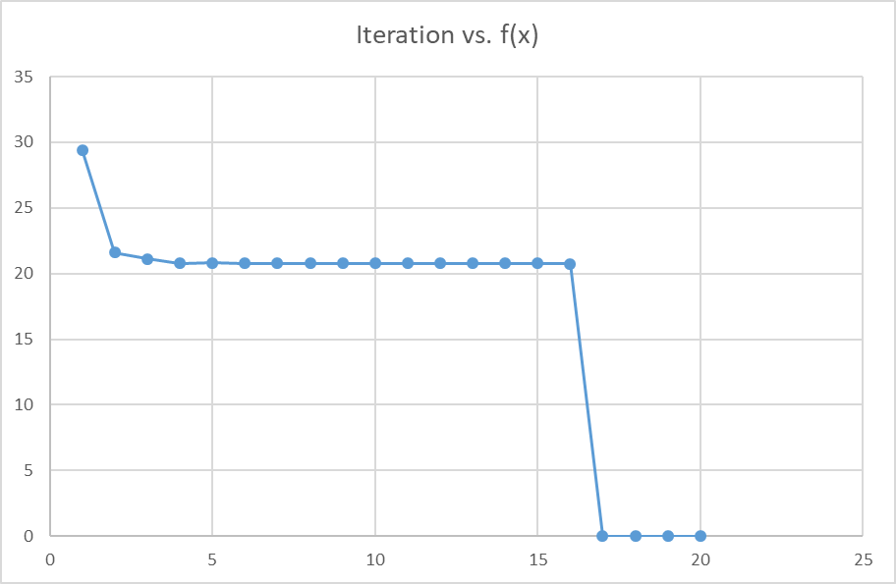

Slide 11
OBSERVATIONS & CONCLUSIONS
Higher the number of variables, higher is the number of iterations.
Smaller the tolerance, higher is the number of iterations.
The multi-variable optimization is not very consistent as single-variable optimization.
The number of iterations are much higher compared to the single-variable optimization iterations.
Conjugate direction method along with secant method and bounding phase method for unidirectional search has been successfully implemented and results have been obtained.

Slide 12
Thank You

